Slide 1
Web Analytics & Social Media Analytics

Slide 2
AGENDA
What is Web Analytics?
What is Social Media Analytics ?
How These Analytics Benefit the Project ?
My Role
How I Can Help

Slide 3
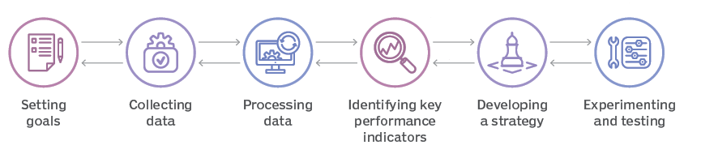
What is Web Analytics
In short Web analytics is the process of collecting, measuring, and analyzing data from your website to understand how visitors interact with it.
Is like counting how many people enter your Website, which page they look at, and how long they stay in the page.

Slide 4
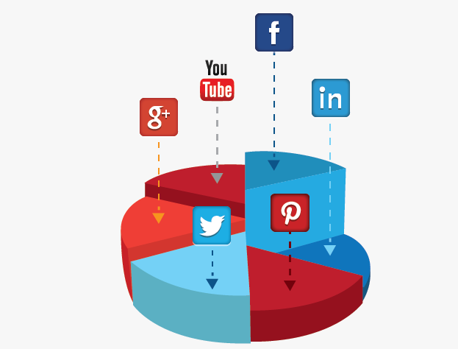
What is Social Media Analytics?
Social media analytics involves tracking and analyzing data from social media platforms like Facebook, Instagram, and Twitter It's like listening to what customers are saying about your brand online—whether they love your products, enjoy your content, or think the service needs improvement.

Slide 5

How These Analytics Benefit the Project ?
Importance of web analytics: It will improve the website's performance, user experience, and conversion rates.
Social media: It will help to understand audience engagement, sentiment, and the effectiveness of social media campaigns.
Improve Decision-Making: Data-driven insights help you make informed decisions, like which products to promote or where to allocate your marketing budget.
Enhance User Experience: Understanding how users interact with your website or social media can help you tailor content to meet their needs.

Slide 6
My Role
Analytics setup
Insight
Reporting
Data Collection
Analytics Setup:. Google Analytics, Facebook Insights, and Instagram Analytics, ensuring they are properly integrated with your website and social media profiles.
Data Collection & Monitoring: Monitor these tools to collect valuable data on user behavior, website traffic, social media engagement, and campaign performance.
Insight Generation: This includes understanding what content resonates with your audience, what drives traffic to your site, and where users drop off in their journey.
Reporting: Will provide you with easy-to-understand reports that summarize key findings and offer actionable insights

Slide 7
THANK YOU
I will help by doing all these with no extra cost ☺

